Slide 1

Be Praising
Psalms
Dr. Rick Griffith • Crossroads International Church Singapore
CICFamily.com • BibleStudyDownloads.org

Slide 2

What do you need most?
(relating to God)
Giving?
Church?
Evangelism?
Obey God?
Read Bible?
Prayer?
Notes:
We all have a variety of needs, but what do you need most?
• Here's a hint: It relates to God.
Think of a one-word answer.
Now discuss this with the person next to you for the next 30 seconds.
• Some might think this place is only about money—so you think I am introducing a sermon on giving!
• Others say that telling others about Christ is our most vital need.
• Still others think that the most important thing any of us can do is to read the Bible.
• Or is going to church just about the most vital action?
• More generally, isn't obeying God the key thing above all else?
• How about talking to Him? Shouldn't that be above everything?
I wonder what you think.

Slide 3

PSALMS
Notes:
If you open your Bible to the middle, it's likely that your eyes will fall on the book of Psalms.
• It lies right at the center of the your Bible, probably for good reason.

Slide 4
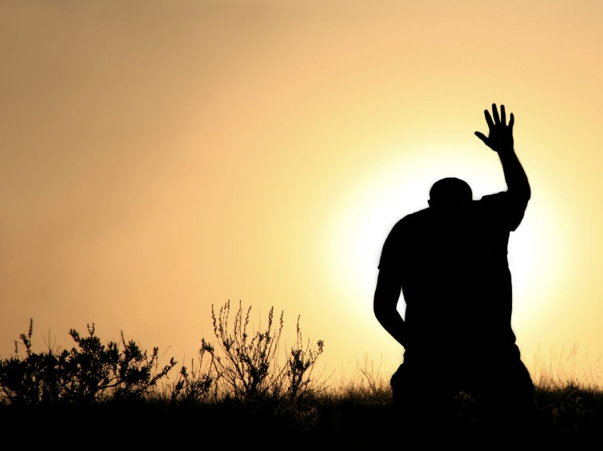
Your greatest need is to praise God.
Main Idea of Psalms
Notes:
Restatement

Slide 5
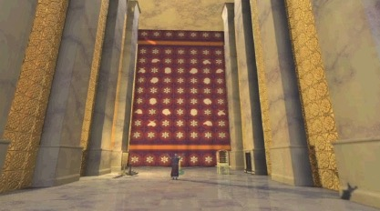
THE PSALMS:
Songs of Worship for the Ages
Notes:
In this book we find the answer to what I believe is our greatest need—worship of God, or, as Jesus said, to love the Lord God.
It provides the songs of worship for the ages.

Slide 6
Key Word
380
343
Praise
Psalms

Slide 7
Theme
380
Praise and petition God
Psalms

Slide 8
Key Verse
380
"Praise the LORD. I will extol the LORD with all my heart in the council of the upright and in the assembly" (Psalm 111:1).
Psalms

Slide 9
Psalms is unique

Slide 10
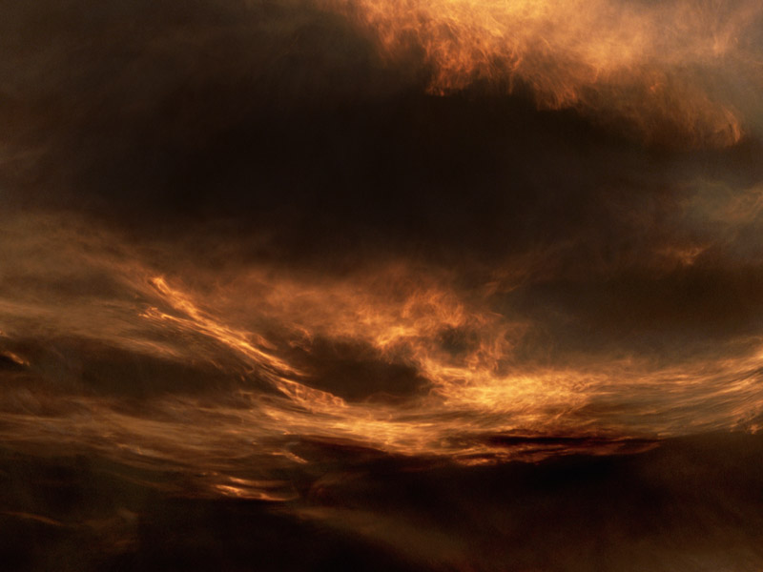
Did You Know?
382
P 5
The Book of Psalms is the…
Most diverse book of the OT

Slide 11
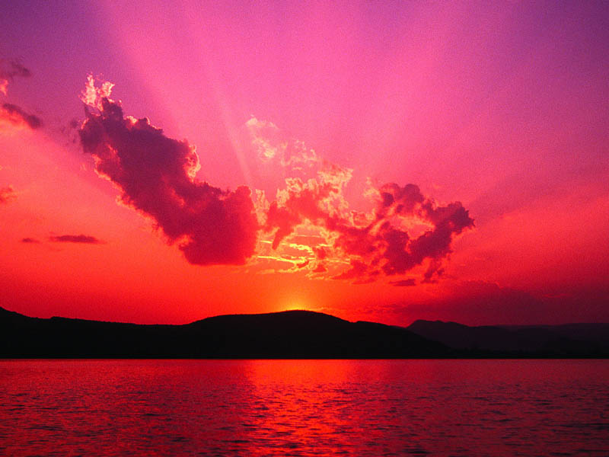
Categories of Psalms
386
P 9
Praise
Messianic
Lament
Testimonial
Pilgrim (Ascent)
Wisdom
Imprecatory
Penitential
Historical
Nature

Slide 12
Did You Know?
382
P 5
The Book of Psalms is the…
Most diverse book of the OT
Longest book in the Bible

Slide 13
Longest Books of the Bible
478
Book | Chapters | Verses | Words
Psalms | 150 | 2461 | 43,743
Jeremiah | 52 | 1364 | 42,659
Ezekiel | 48 | 1273 | 39,407
Genesis | 50 | 1533 | 38,267
Isaiah | 66 | 1292 | 37,044
http://www.kneeholedesk.com/Pages/Did_You_Know/Books_of_the_Bible.html

Slide 14
Did You Know?
382
P 5
The Book of Psalms is the…
Most diverse book of the OT
Longest book in the Bible
Most OT quotes in the NT (at least 119)
Source of the most memorized poem

Slide 15

Psalm 23
¹The LORD is my shepherd, I shall not be in want. ²He makes me lie down in green pastures, he leads me beside quiet waters, ³he restores my soul. He guides me in paths of righteousness for his name's sake. ⁴Even though I walk through the valley of the shadow of death, I will fear no evil, for you are with me; your rod and your staff, they comfort me. ⁵You prepare a table before me in the presence of my enemies. You anoint my head with oil; my cup overflows. ⁶Surely goodness and love will follow me all the days of my life, and I will dwell in the house of the LORD forever.

Slide 16
Psalms teaches praise

Slide 17
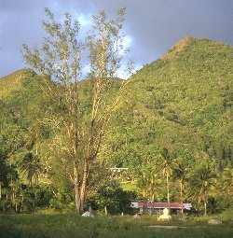
Purpose
381
The Psalms constitute a hymnal of Israel, as a means to worship & praise God
Psalms help God's people to find their way through varying experiences of life (serve as expressions of human feelings)

Slide 18

Key Word
Praise
380
P 3

Slide 19
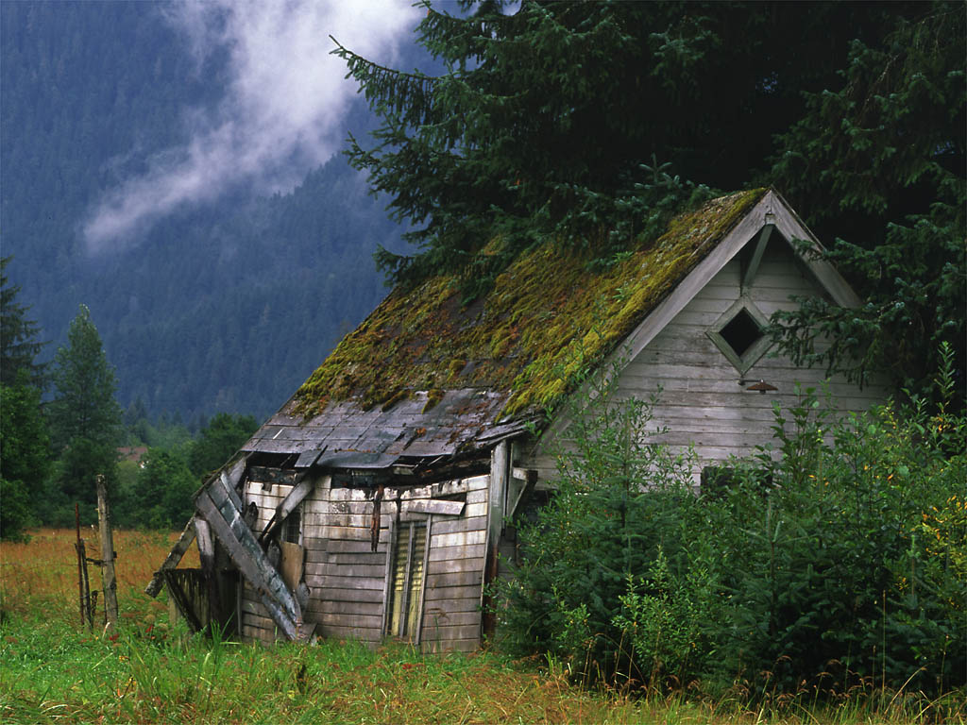
Key Verse
381
P 3
Psalm 111:1
"Praise the LORD. I will extol the LORD with all my heart in the council of the upright and in the assembly."

Slide 20

Summary Statement
380,
383
Praise and petition God for who He is and what He has done in providing wisdom, protection, Messianic fulfillment, and His Word to be humble before Him in trust and thanksgiving
Psalms

Slide 21

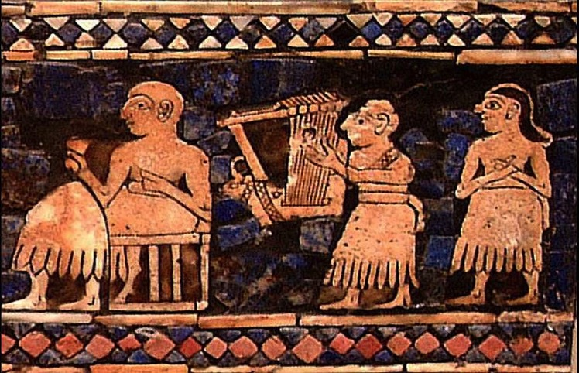
TITLES FOR THE BOOK
381
P 4
Hebrew | Tehilim | Book of Praises
Greek | Psalmoi | Poems sung to the accompaniment of musical instruments
Latin | Liber Psalmorum | Book of Psalms
English | Psalms, The Psalter | Titles reflect musical nature

Slide 22
Psalms grew in stages

Slide 23
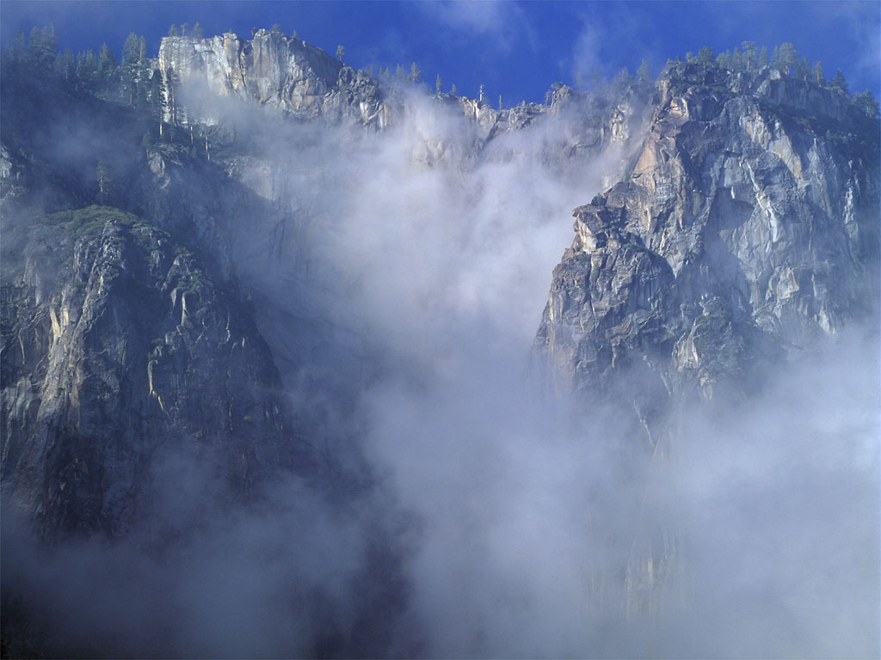
Key Authors:
David & Asaph
381
P 4

Slide 24
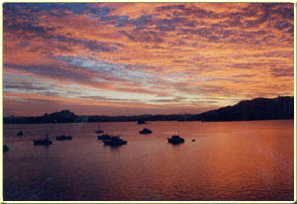
Authorship
dwd
l
381
"to David"
P 4
"for David"
"of David"
External evidence:
Superscriptions to many psalms are challenged by scholars due to the usage of Hebrew preposition "lamed"
However, its use to designate authorship is common in Northwestern Semitic inscriptions and other Semitic dialects—as well as "of Habakkuk" (Hab. 3:1)

Slide 25
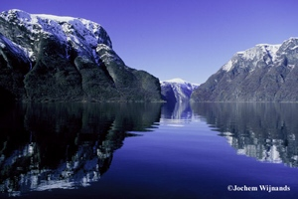
Authorship
381
P 4
Internal evidence:
50 psalms: Anonymous
100 psalms: 7 authors

Slide 26
AUTHORSHIP
388a
P 3
 | Book 1 | Book 2 | Book 3 | Book 4 | Book 5
Chapter | 1-41 | 42-72 | 73-89 | 90-106 | 107-150
Number of Psalms | 41 | 31 | 17 | 17 | 44
Chief Author | David | David / Korah | Asaph | Anonymous | David / Anonymous

Slide 27
About the Authors
381
P 4
David: "Beloved of Yahweh"
• the second king of Israel
• wrote 73 pss.

Slide 28
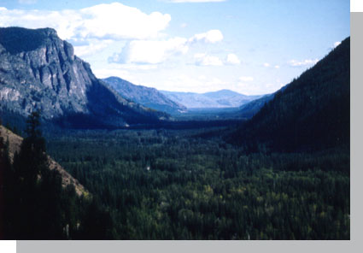
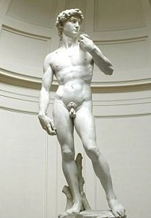
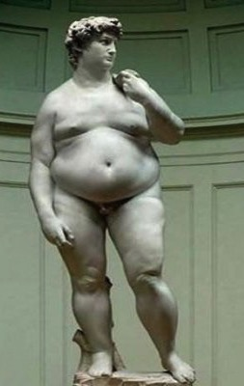




Which David?
381
Michaelangelo's David
(Italy, 1504)
David after overseas tour (USA, 2015)

Slide 29
About the Authors
381
P 4
David: "Beloved of Yahweh"
• the second king of Israel
• wrote 73 pss.
Asaph: "Collector"
• a Levite descending from Gershom
• an eminent musician
• wrote 12 pss. (Pss. 50, 73–83)

Slide 30
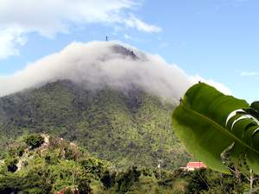
About the Authors
381
P 4
3. The Sons of Korah: "bald"
• a guild of singers & composers
• from Levi in the line of Kohath
• wrote 10 pss. (pss. 42, 44-49, 84, 85, 87)
4. Solomon: "peaceful"
• 3rd king of Israel
• son of David & Bathsheba
• wrote 2 pss. (pss. 72, 127)

Slide 31


About the Authors
381
P 4
5. Moses: "Son of the water"
• leader of Israel from Egyptian bondage
• author of oldest psalm (Ps. 90)
6. Heman the Ezrahite: "Faithful"
• Levite from family of Kohath
• Wrote Ps. 88
7. Ethan the Ezrahite: "Enduring"
• Levite from the family of Merari
• Wrote Ps. 89

Slide 32
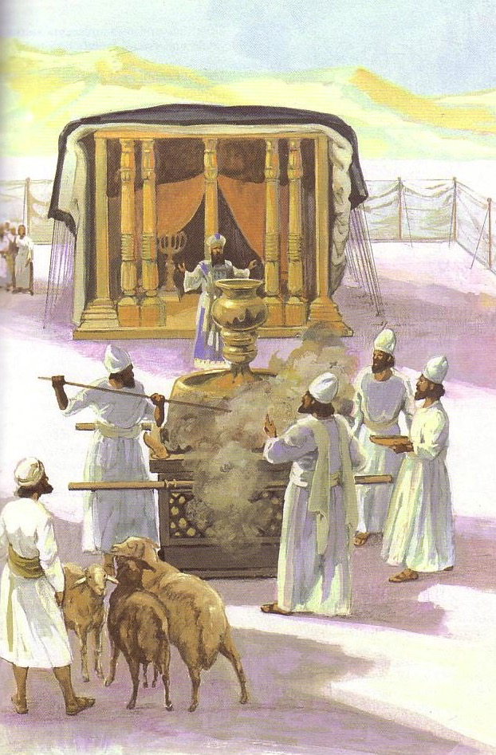
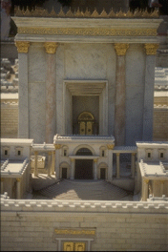
Occasion
381
P 4
Psalms developed in the transition from the tabernacle to the first temple under Solomon

Slide 33

Psalms Covers 1000 Years
381
P 4
Moses
Ps. 90
ca. 1400 BC
David
73 pss.
1000
Postexilic
Ps. 126
430 BC
2000
1800
1600
1400
1200
1000
800
6 0 0
4 0 0
200
BC/AD
200
400
600

Slide 34
DATES OF COMPOSTION
388a
P 4
1400 BC
1000 BC
971 BC
931 BC
722 BC
500 BC
Moses
David
Solomon
Divided Kingdom
Exile
Restoration
Most of the Psalms were written here

Slide 35
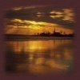
Classifications by Book
P 3
Book 1: Pss. 1–41
Book 2: Pss. 42–72
Book 3: Pss. 73–89
Book 4: Pss. 90–106
Book 5: Pss. 107–150
Each of these 5 books ends with a doxology

Slide 36
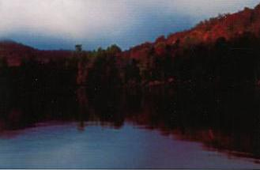
Reasons for Classifications
382
P 5
1. Some Jews believed that the five sections mirror the Pentateuch, but these really have no correspondence

Slide 37

Covenant Relationship with God
382
P 5
 | Book of Pentateuch | Correspondence
Book 1 | Genesis | Man: the godly man, the ungodly man, the Son of Man
Book 2 | Exodus | Story of Israel's ruin, redemption; ends with a Kingdom Psalm
Book 3 | Leviticus | Sanctuary: references to holiness, congregation, Zion; 11/12 Asaph psalms
Book 4 | Numbers | Wilderness: references to Moses, wilderness, failures & rebellions
Book 5 | Deuteronomy | Restates counsels of God, claims of the Law, anticipation of blessings

Slide 38

Classification View 1: Mirroring the Pentateuch
383
BOOK 1 | BOOK 2 | BOOK 3 | BOOK 4 | BOOK 5
41 Psalms 1 | 31 Psalms 42 | 17 Psalms 73 | 17 Psalms 90 | 44 Psalms 107 150
41:13 | 72:18-20 | 89:52 | 106:48 | 150:6
ADORING WORSHIP | WONDERING WORSHIP | CEASELESS WORSHIP | SUBMISSIVE WORSHIP | PERFECTED WORSHIP
GENESIS -man- | EXODUS -Israel- | LEVITICUS -sanctuary- | NUMBERS -Moses & wilderness- | DEUTERONOMY - Law & land-
mainly (or all) DAVID | mainly DAVID & KORAH | mainly ASAPH | mainly ANONYMOUS | mainly DAVID
ORIGINAL GROUP BY DAVID | BOOKS 2 & 3 ADDED IN THE REIGNS OF HEZEKIAH & JOSIAH |  | MISCELLANEOUS COLLECTIONS COMPILED IN TIMES OF EZRA & NEHEMIAH
P 6
DOXOLOGY AT THESE VERSES
TOPICAL LIKENESS TO PENTATEUCH
A
U
T
H
O
R
S
POSSIBLE STAGES OF COLLECTION
Irving L. Jensen

Slide 39

Reasons for Classifications
382
P 5
2. Herbert C. Leupold & A. A. Anderson postulate that divisions resulted a book at a time from chronological development.

Slide 40
COMPILATION
380
P 3
 | Book 1 | Book 2 | Book 3 | Book 4 | Book 5
Possible Compiler | David | Hezekiah or Josiah |  | Ezra or Nehemiah
Possible Dates of Compilation | c. 1020 – 970 BC | c. 970 – 610 BC |  | Until c. 430 BC

Slide 41
Psalms Book Chart
Praise and Petition God
 | Book 1 (1–41) | Book 2 (42–72) | Book 3 (73–89) | Book 4 (90–106) | Book 5 (107–150)
Number | 41 | 31 | 17 | 17 | 44
Authors and Number of Psalms Authored | David-37 Anon-4 | David-18 Korah-7 Anon-4 Solomon-1 Asaph-1 | Asaph-11 Korah-3 Ethan-1 Heman-1 David-1 | Anon-14 David-2 Moses-1 | Anon-28 David-15 Solomon-1
Main Type | Lament-22 | Lament-21 | Lament-9 | Praise-12 | Praise-22
Closing Doxology | 41:13 | 72:18-19 | 89:52 | 106:48 | 150:1-6
Possible Complier | David | Hezekiah or Josiah |  | Ezra or Nehemiah
Possible Compilation Dates | 1020-970 BC | 970-610 BC |  | Until c. 430 BC
Span of Authorship | About 1000 Years (about 1410-430 BC)
Psalms
380
P 3
Notes:
The five books likely represent periods of compilation. Even though Ps 72 ends the second book with “this concludes the prayers of David son of Jesse” (72:20), it did so only at that point of the development of the whole book. Yet within the 600 years of enlarging the book(s) from about 1000 to 400 BC, at least 17 more Davidic psalms would be added. We do not know the author of 50 psalms, so some of these also may have been written by David. This all shows us that, in a human sense, David and the covenant God gave him occupy the primary theme of the work.

Slide 42
Psalms is a guide for prayer

Slide 43
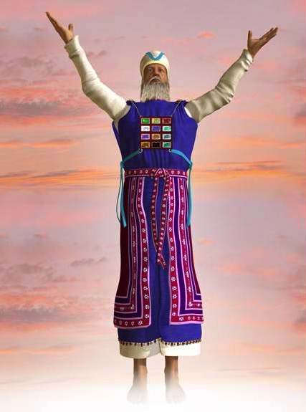
Pray Through Psalms
"Let the words of my mouth and the meditation of my heart be acceptable in Your sight, O LORD, my strength and my redeemer"
—Psalm 19:14

Slide 44
How to Pray Through a Psalm
One verse per person
Paraphrase and personalize it
Make no requests

Slide 45
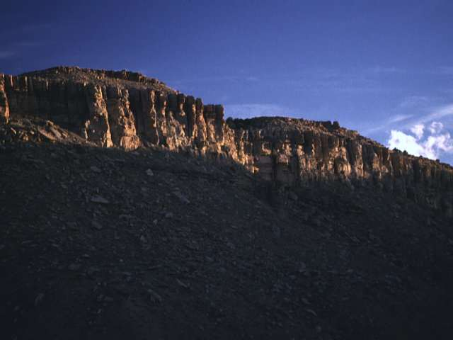
Pray Psalm 111 with Two Others
111:1 "Praise the LORD! I will give thanks to the LORD with my whole heart, in the assembly of the godly and the congregation."

Slide 46
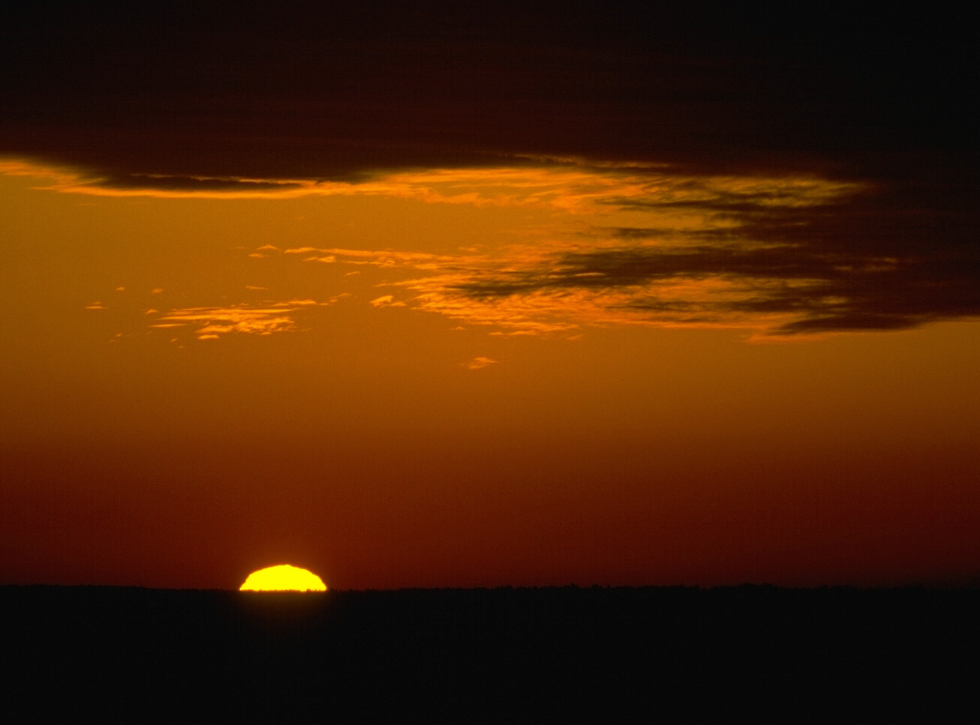
Pray Psalm 111 with Two Others
111:2 "The LORD's deeds are great, eagerly awaited by all who desire them."

Slide 47
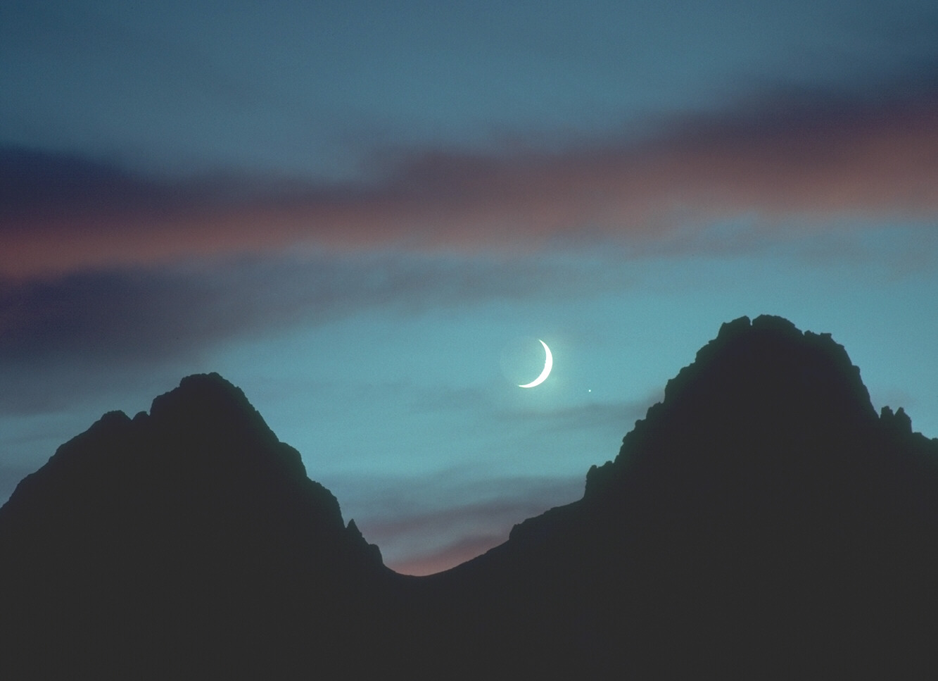
Pray Psalm 111 with Two Others
111:3 "His work is majestic and glorious, and his faithfulness endures forever."

Slide 48

Pray Psalm 111 with Two Others
111:4 "He does amazing things that will be remembered,
The LORD is merciful and compassionate."

Slide 49

Pray Psalm 111 with Two Others
111:5 "He gives food to his faithful followers, he always remembers his covenant."

Slide 50
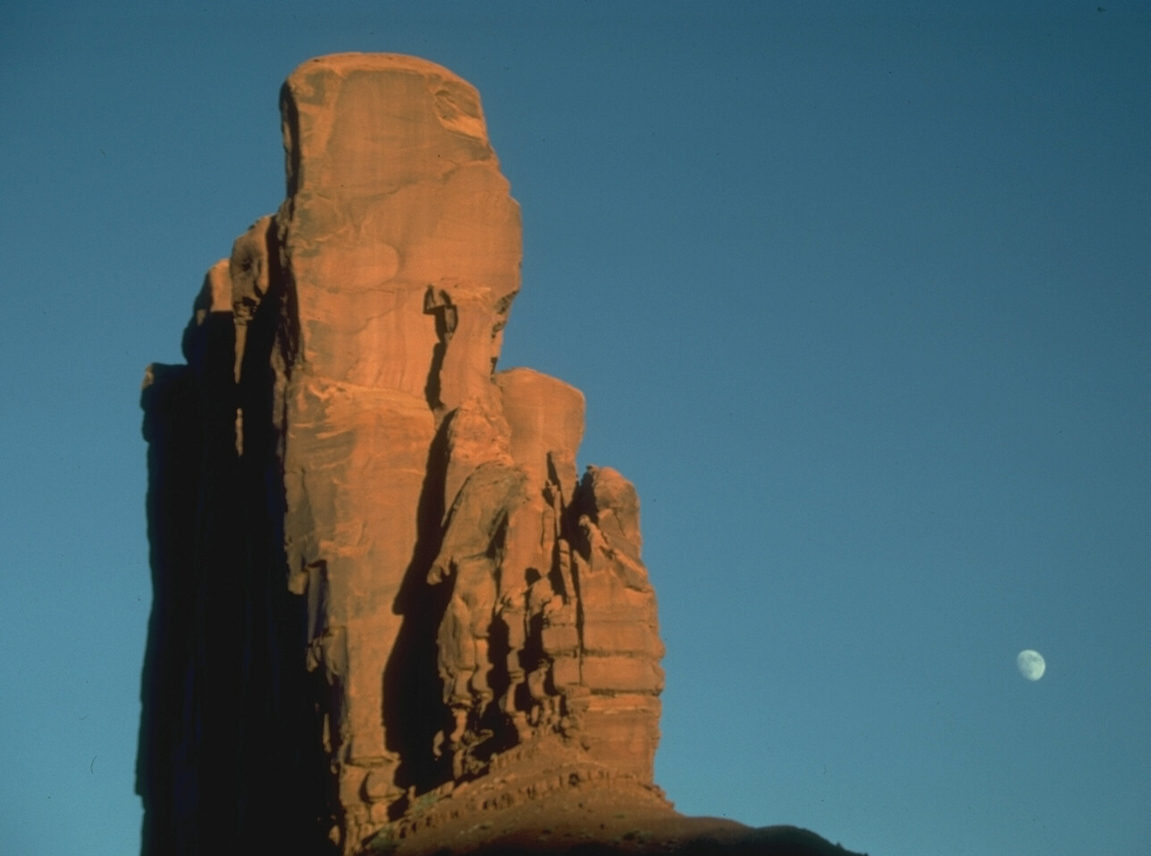
Pray Psalm 111 with Two Others
111:6 "He announced that he would do mighty deeds for his people, giving them a land that belonged to other nations."

Slide 51
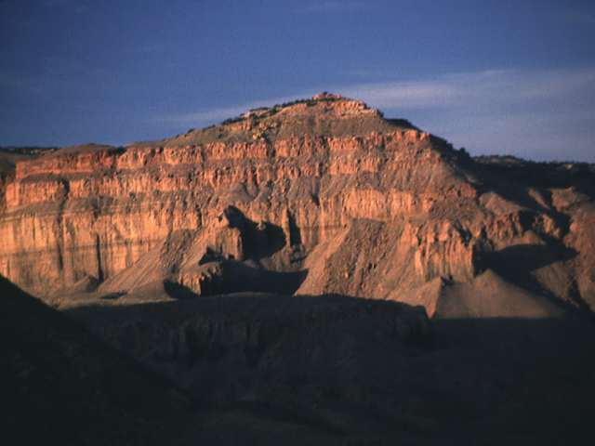
Pray Psalm 111 with Two Others
111:7 "His acts are characterized by faithfulness and justice, all his precepts are reliable."

Slide 52
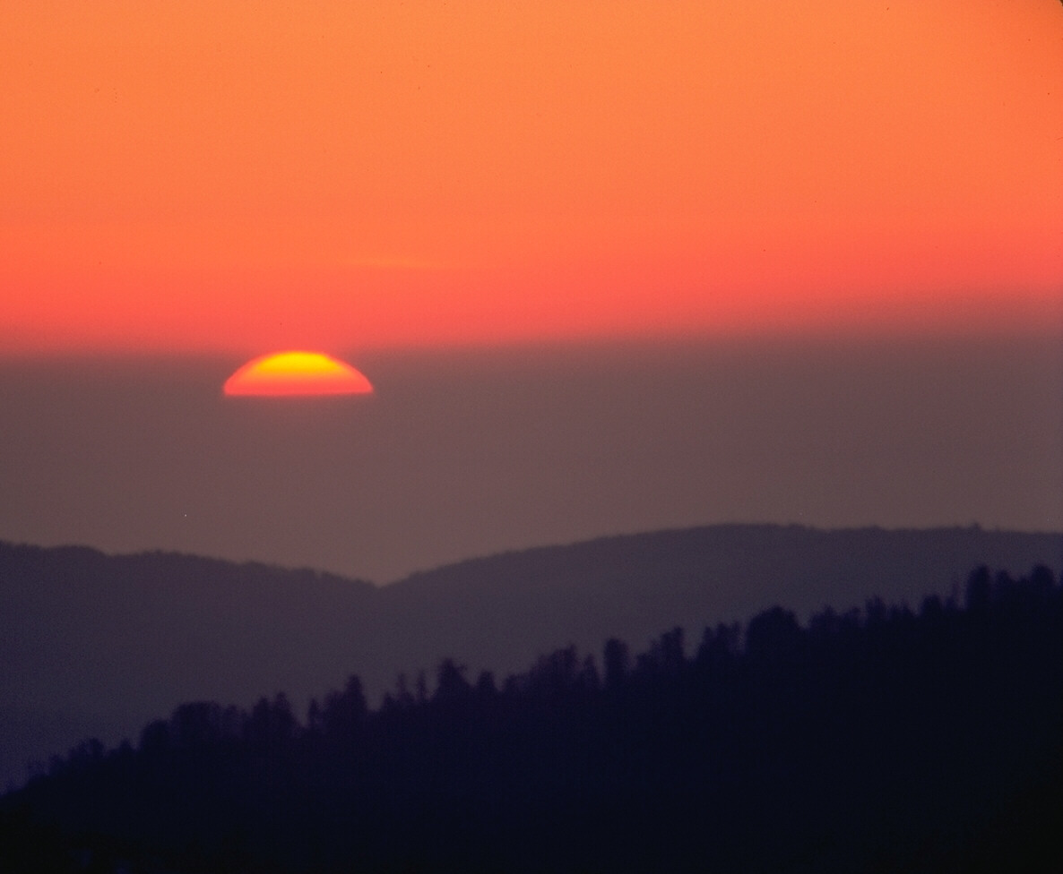
Pray Psalm 111 with Two Others
111:8 "They [His precepts] are forever firm, and should be faithfully and properly carried out."

Slide 53
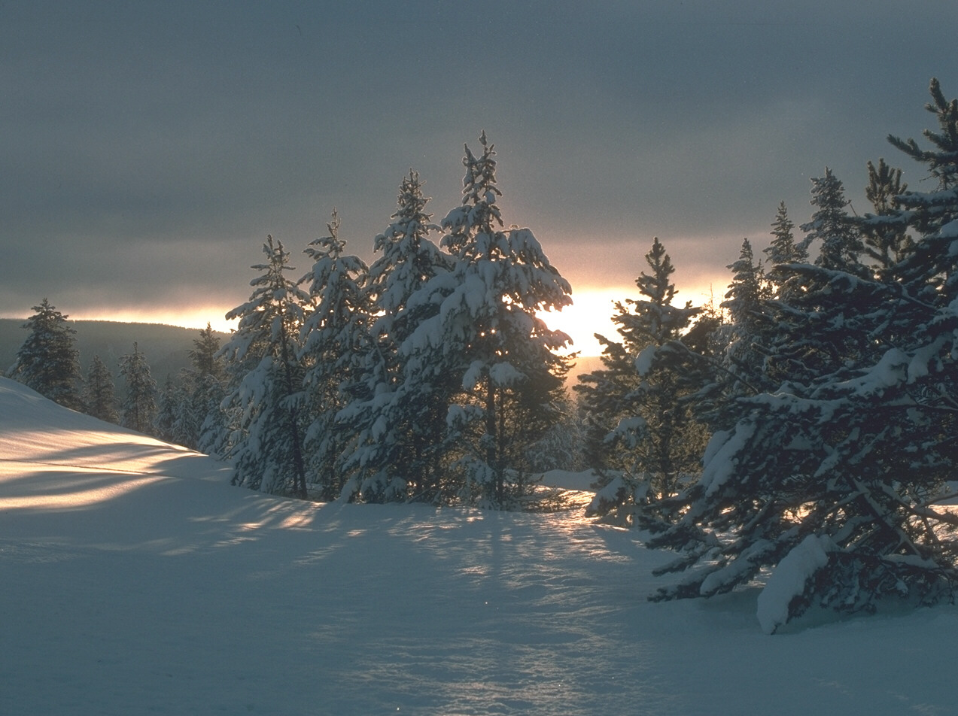
Pray Psalm 111 with Two Others
111:9 "He delivered his people, he ordained that his covenant be observed forever. His name is holy and awesome."

Slide 54
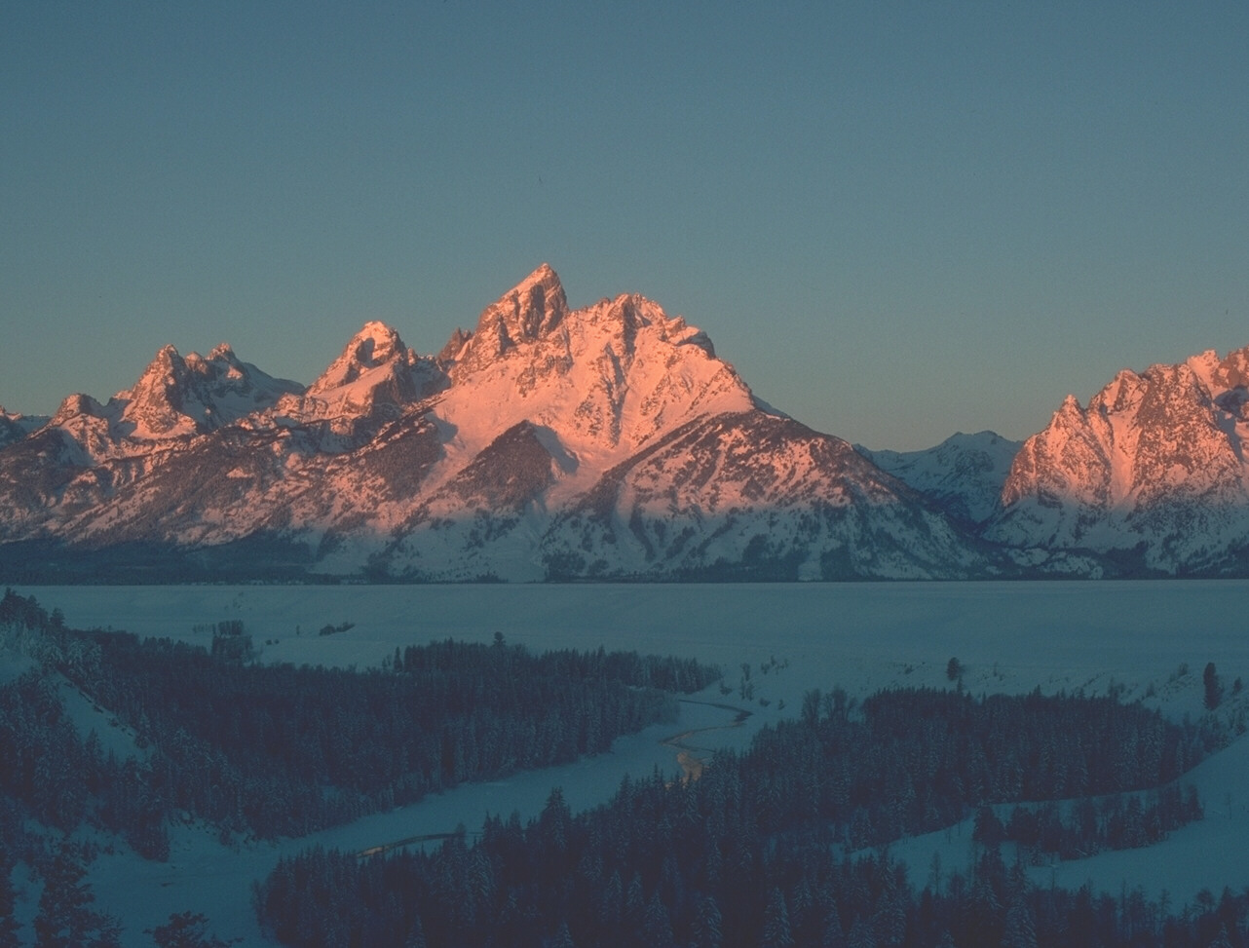
Pray Psalm 111 with Two Others
111:10 "To obey the LORD is the fundamental principle for wise living, all who carry out his precepts acquire good moral insight. He will receive praise forever."

Slide 55
Overview
388b
Introduction
What place did the Psalms have in OT times?
How did the Israelites worship God through the Psalms?
How are the Psalms relevant for Christians today?

Slide 56
Psalms come in many types

Slide 57

Types of Psalms
388c
Types of Psalms
P 41
Messianic
Lament
Imprecatory
History
My God, my God, why have you forsaken me?
Why are you so far from saving me,
so far from the words of my groaning?
(Ps. 22:1 NIV)

Slide 58
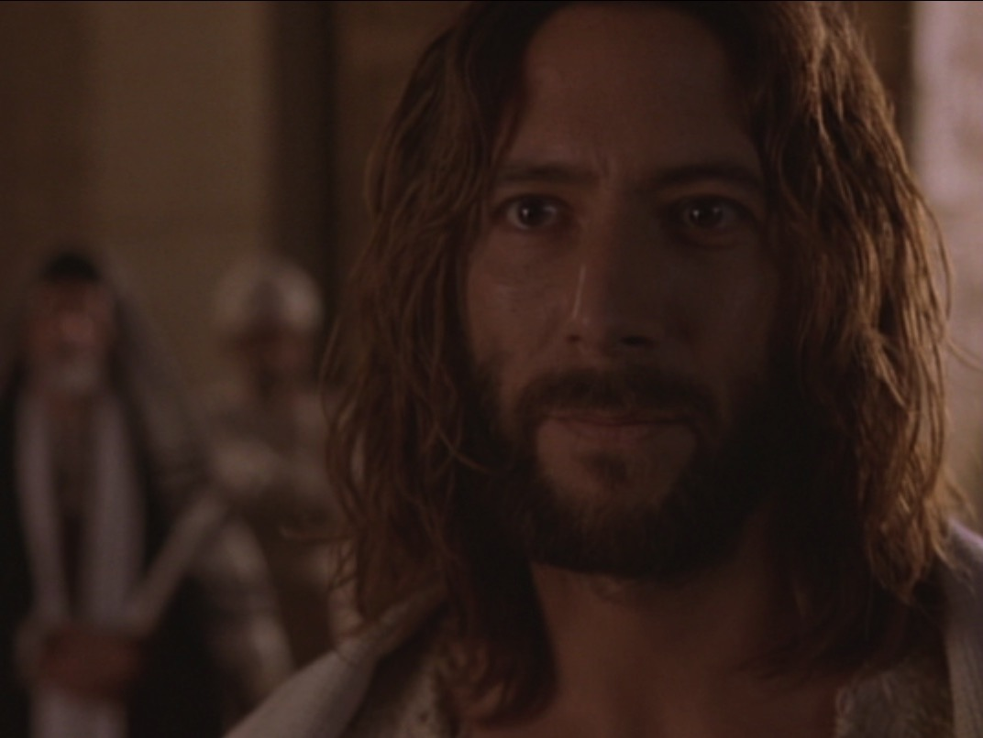
Fulfilled Messianic Prophecies in Psalms
388
P 43
Ps | Reference to Christ | NT Fulfillment
2:7 | The Messiah will be God's Son | Heb. 1:5
16:10 | He will rise from the dead | Acts 2:25-31
22:16 | His hands & feet will be pierced | John 20:25, 27
45:6 | His throne will be forever | Heb. 1:8
110:1 | He is David's son & God's Son | Matt 22:44
110:4 | He is the eternal priest-king | Heb. 6:20

Slide 59

Jerusalem
27
Disadvantages
Advantages
Stages
Jebusite (1500 BC)
Solomon (971 BC)
Hezekiah (700 BC)
Hezekiah (700 BC)
586 BC
Nehemiah (444 BC)
Hasmonean (100 BC)
Herod the Great (20 BC)
Modern Walls

Slide 60
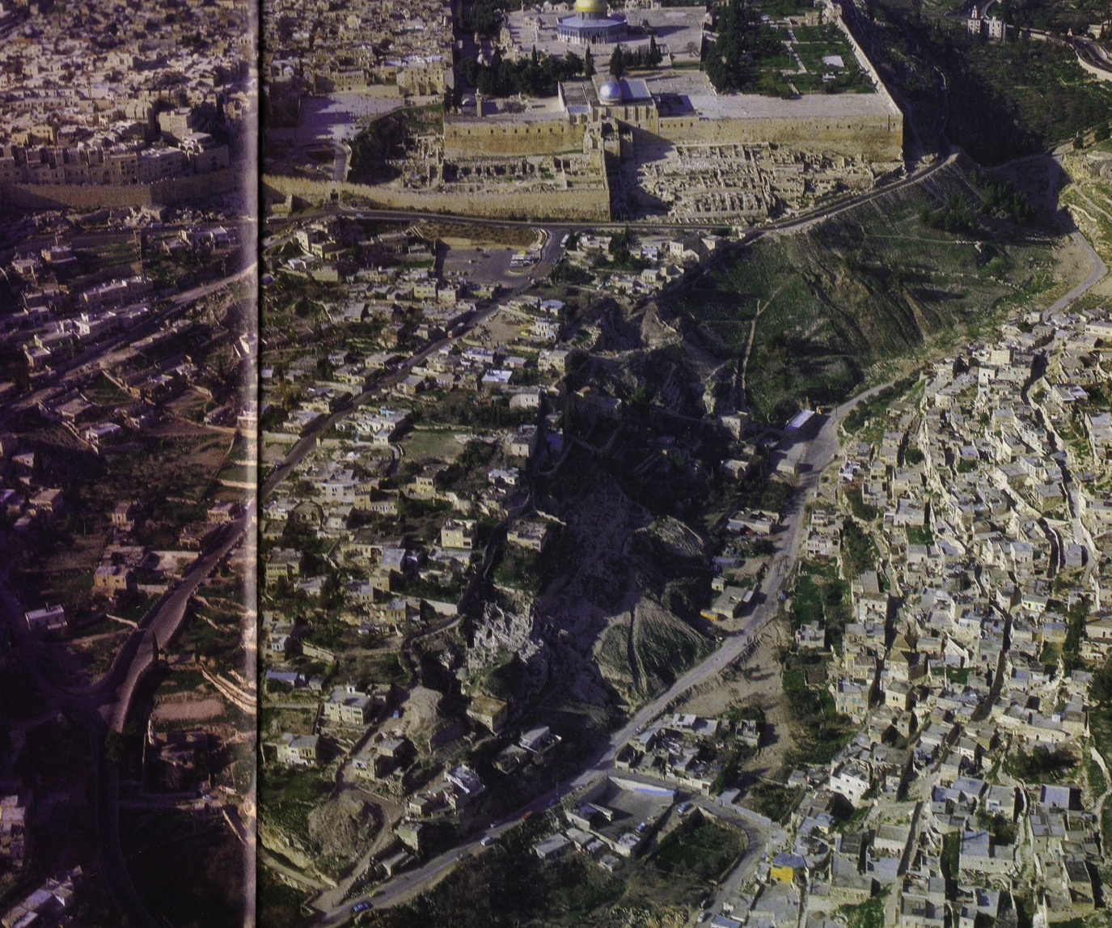
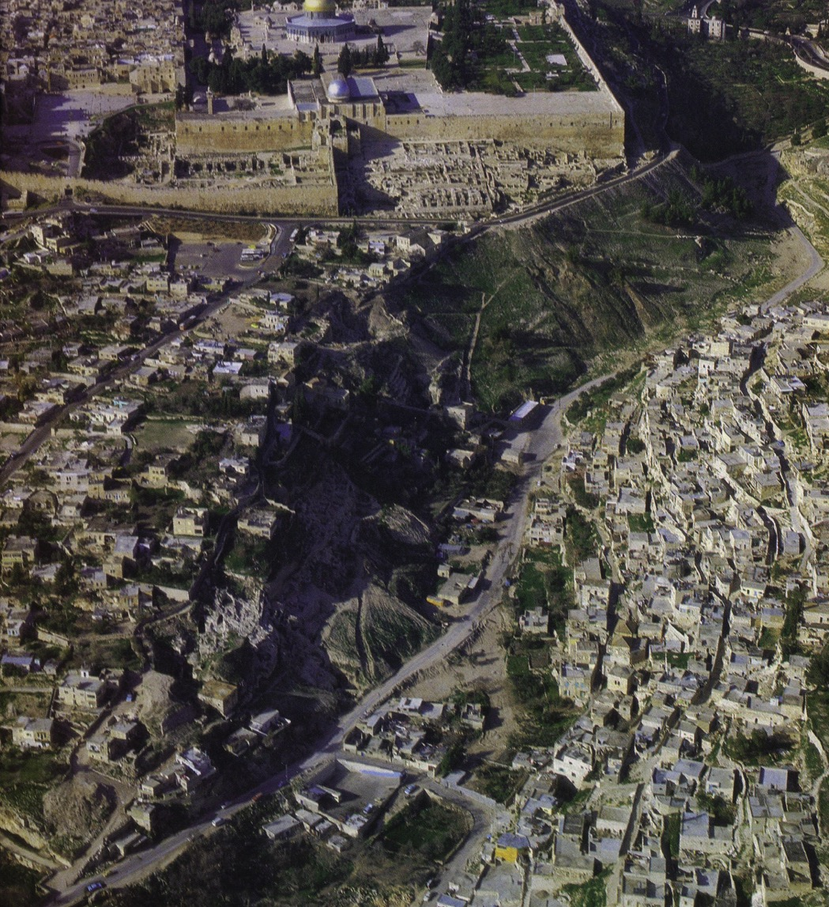
Present City
Herod's Extension
Southeast Corner
City of David

Slide 61
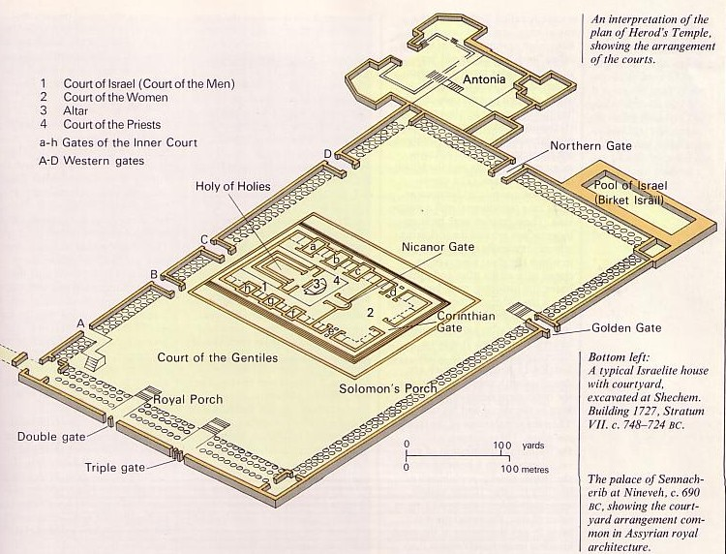
Herod's Temple Mount

Slide 62
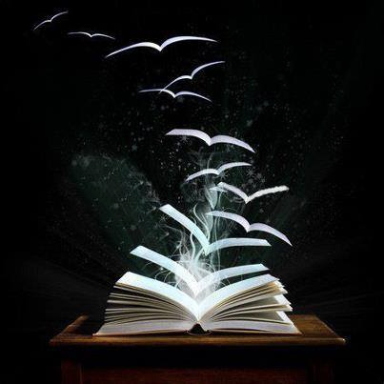
15 Ascent Psalms
Psalms 120–134

Slide 63
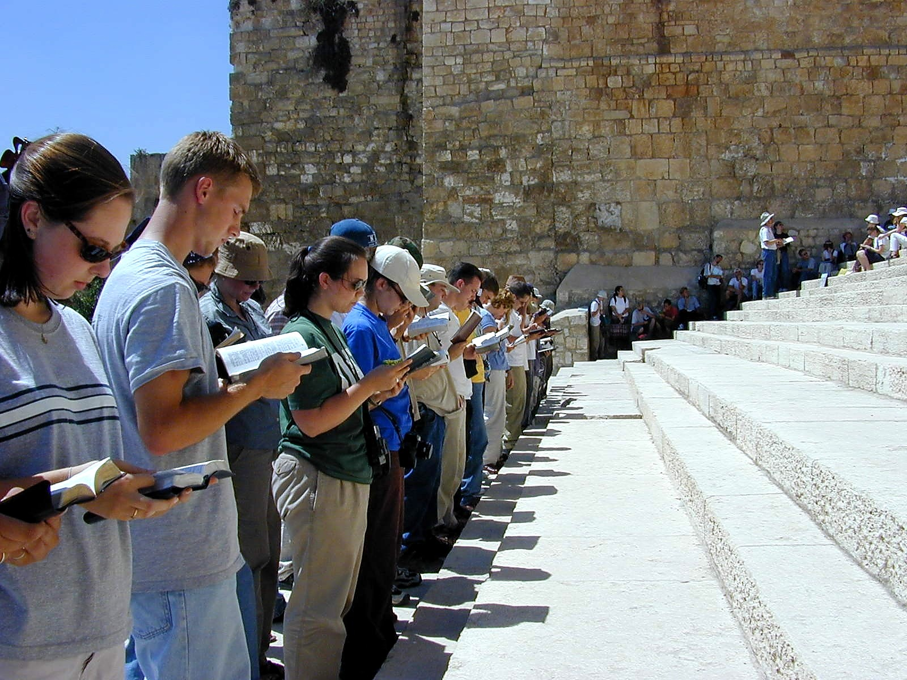
Modern Pilgrims

Slide 64
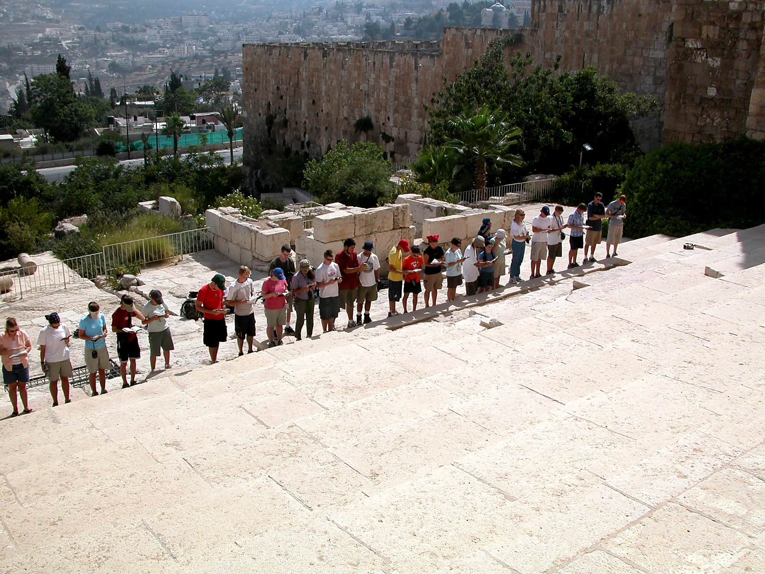
Modern Pilgrims

Slide 65
Categories of Psalms
386
P 9
Messianic
Nature
Testimonial
Pilgrim (Ascent)
Wisdom
Imprecatory
Penitential
Historical

Slide 66
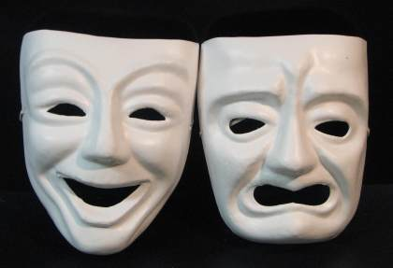
Praise & Lament

Slide 67
Individual Psalms Classified Generally
Source: Westermann
384
P 7
Praise (Worship): Worship of God for what He has done & for who He is |  |  | Lament (Petition): Request from God based on what He has done & for who He is
Declarative: Actions of God |  | Descriptive: Attributes of God | Individual |  | People
Individual | People |  | Open | Heard

Slide 68
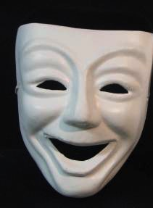
Praise Psalms

Slide 69
Descriptive Praise
“Sing joyfully to the LORD, you righteous;
it is fitting for the upright to praise Him.
Praise the LORD with the harp;
make music to him on the ten-stringed lyre.
Sing to him a new song; play skillfully,
and shout for joy.”
Psalm 33:1-3

Slide 70
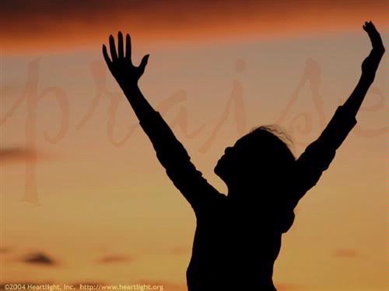
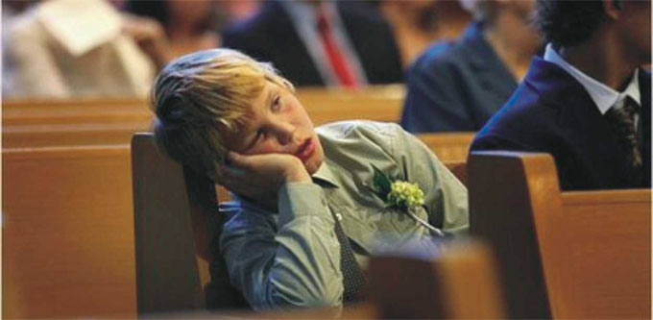
We need to praise God today!
P 7

Slide 71
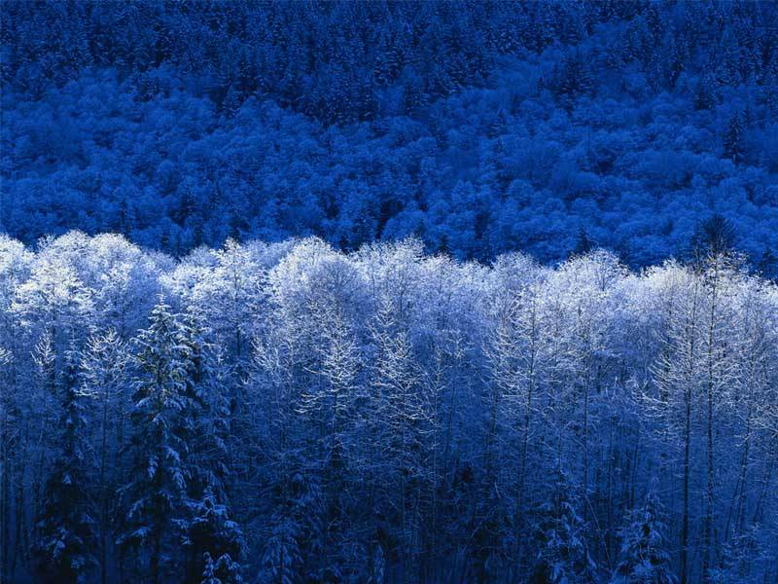
Types of Psalms
388c
P 28
Hymn (Descriptive Praise)
Penitential
Wisdom
Royal
Messianic
Lament
Imprecatory
History
“Sing to the LORD a new song,
for he has done marvelous things;
His right hand and his holy arm
have worked salvation for him.”
(Ps. 98:1)

Slide 72
Types of Psalms
388c
P 30
P 8
Hymn Structure (Descriptive Praise)
Prologue: e.g., "Hallelujah"
Call to Praise
Cause for Praise
Conclusion: Renewed Call to Praise
Epilogue: e.g., "Hallelujah"

Slide 73
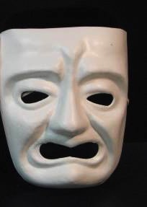
Lament Psalms

Slide 74
Lament
"LORD, hear my prayer!
Listen to my plea!
²Don't turn away from me
in my time of distress.
Bend down to listen,
and answer me quickly when I call to you."
Psalm 102:1-2 NLT

Slide 75

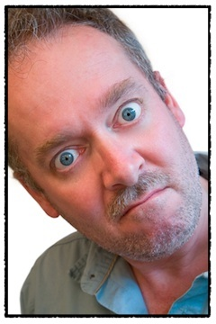



When Can We Complain?
Numbers:
Complaining Judged
Psalms:
Complaining Allowed
Legitimate complaining is to the one who can solve the problem!

Slide 76

Lament to God Alone
"Hear my prayer, O LORD;
let my cry for help come to you.
Do not hide your face from me
when I am in distress.
Turn your ear to me;
when I call, answer me quickly."
Psalm 102:1-2

Slide 77
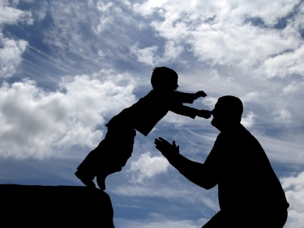
Songs of Trust
P 31
These lament psalms have extended confidence sections

Slide 78
Psalm 23 is a Song of Trust
¹The LORD is my shepherd, I shall not be in want. ²He makes me lie down in green pastures, he leads me beside quiet waters, ³he restores my soul. He guides me in paths of righteousness for his name's sake. ⁴Even though I walk through the valley of the shadow of death, I will fear no evil, for you are with me; your rod and your staff, they comfort me. ⁵You prepare a table before me in the presence of my enemies. You anoint my head with oil; my cup overflows. ⁶Surely goodness and love will follow me all the days of my life, and I will dwell in the house of the LORD forever.

Slide 79
Types of Psalms
388c
Hymn
Penitential
Wisdom
Royal
Messianic
Lament
Imprecatory
History
“Then I acknowledged my sin to you
and did not cover up my iniquity.
I said, ‘I will confess
my transgressions to the Lord’
And you forgave
the guilt of my sin.”
(Ps. 32:5)

Slide 80
Types of Psalms
388c
Types of Psalms
“Why are you downcast, O my soul?
Why so disturbed within me?”
(Ps. 42:5)
Hymn
Penitential
Wisdom
Royal
Messianic
Lament
Imprecatory
History

Slide 81
Types of Psalms
388c
P 18
Lament Structure (Petition Psalm)
Address/Lament
Confession of Trust (Confidence)
Petition
Vow of Praise (Declarative)

Slide 82
Petition
Vindicate me, O God, and plead my cause… rescue me from deceitful and wicked men.
Psalm 43:1

Slide 83
Types of Psalms
388c
P 28
Hymn
Penitential
Wisdom
Royal
Messianic
Lament
Imprecatory
History
Blessed is the man
who does not walk in the counsel of the wicked
(Ps. 1:1)

Slide 84
Types of Psalms
388c
For God is the King of all the earth;
sing to Him a psalm of praise
(Ps. 47:7)
Hymn
Penitential
Wisdom
Royal
Messianic
Lament
Imprecatory
History
O Lord, the king rejoices in your strength.
How great is his joy in the victories you give!
(Ps. 21:1)

Slide 85
Types of Psalms
388c
Types of Psalms
P 47
Hymn
Penitential
Wisdom
Royal
Messianic
Lament
Imprecatory
History
Pour out your wrath on them;
let your fierce anger overtake them.
(Ps. 69:24)
Imprecatory Psalms
May they be blotted out of the book of life
and not be listed with the righteous.
(Ps. 69:28)

Slide 86
Types of Psalms
388c
Types of Psalms
He did miracles in the sight of their fathers;
in the land of Egypt, in the region of Zoan.
He divided the sea and led them through;
He made the water stand firm like a wall.
(Ps. 78:12-13)
Hymn
Penitential
Wisdom
Royal
Messianic
Lament
Imprecatory
History

Slide 87
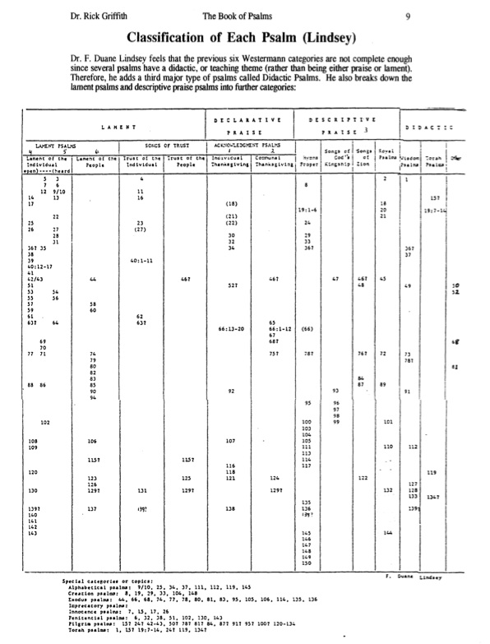
Classification of Each Psalm (Lindsey)
386
P 9

Slide 88
Praise is in Every Psalm!
"My mouth shall speak the praise of the LORD, and all flesh shall bless his holy name forever and ever"
(Psalm 145:21)

Slide 89
Psalms must be correctly interpreted

Slide 90
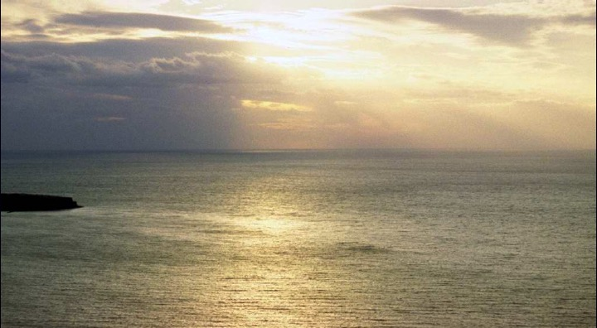
Characteristics of Hebrew Poetry
390
P 13
Stress Patterns (not rhymes)
Evocative language
Acrostic Arrangement
Thought Rhyme

Slide 91

The Key:
Hebrew Parallelism
390
P 13

Slide 92
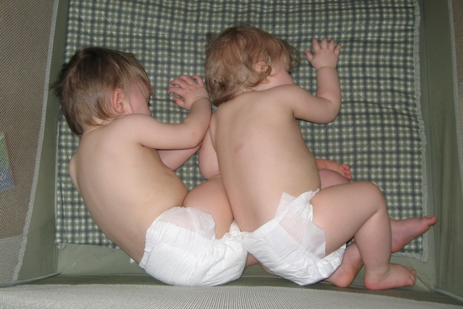
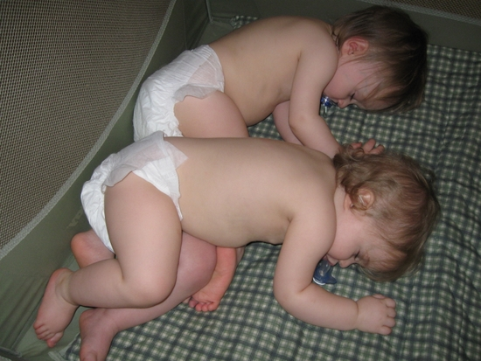
What is Parallelism?
390
P 13
"the repetition of meaning in parallel expressions"
(Ross, BKC, 1:780)

Slide 93
PARALLELISM
388c
“Then He rebukes them in his anger
And in his wrath he terrifies them.”
(Psalm 2:5)
Semantic parallelism:
rebukes and terrifies
anger and wrath are parallel in meaning
Grammatical parallelism:
Verb -- direct object -- prepositional phrase
Prepositional phrase -- verb -- direct object
Similarities & Differences
Two categories of Parallelism :
Grammatical Parallelism (syntax)
Semantic Parallelism (meaning of words)

Slide 94

Tips for Interpreting the Psalms
391
P 14
Pay attention to structure
Summarize the psalm in a sentence (p. 387)
Consider titles and background information in their superscriptions
Classify the psalm using Lindsey's p. 386
Interpret the psalm's incomplete theology in light of NT revelation (e.g., Ps. 51:11)
Reword figures of speech and parallelisms
Use NT allusions and/or quotations but don't read back into the text what the OT author would not have understood (e.g., Ps. 16:10 expanded in Acts 2:25-31)

Slide 95
Tips for Interpreting the Psalms
391
P 14
Read psalms slowly (in our speed-reading day).
Graph the emotional outline of the psalm.
e.g., Psalm 77
Does it start high or low?
77:1-3
77:4-9
77:10
77:11-20

Slide 96
Your greatest need is to praise God.
Main Idea of Psalms
Notes:
Restatement

Slide 97
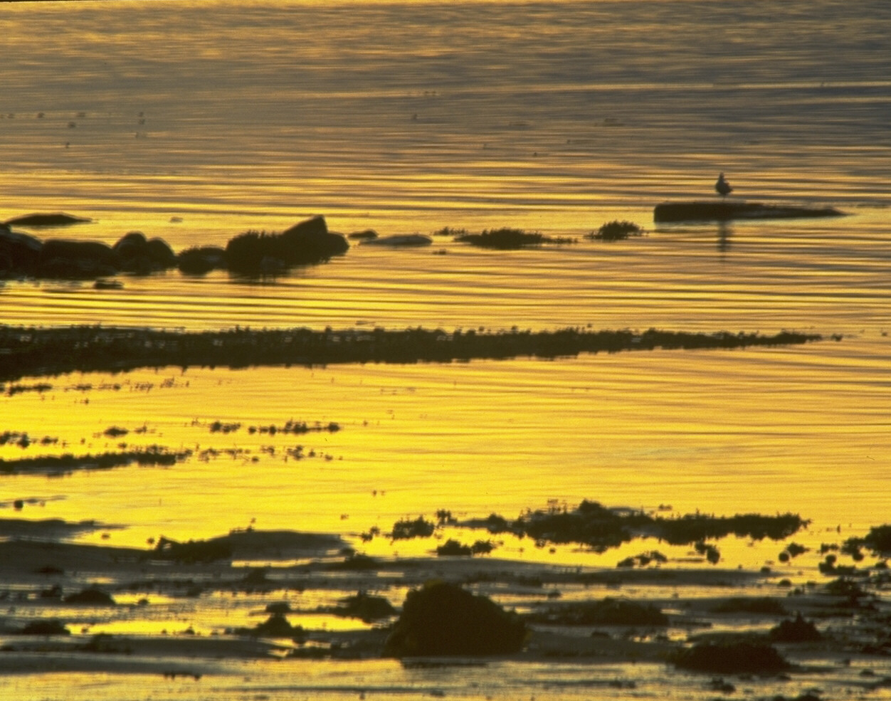
Relevance of the Psalms
Prayer and worship
"constitute an antidote to idolatrous living"
~ Dr. Ho Chiao Ek
(Covenant EFC Singapore)

Slide 98

Psalm 46:10
"Be still and know that I am God."

Slide 99
Summary Statement
380,
383
Praise and petition God for who He is and what He has done in providing wisdom, protection, Messianic fulfillment, and His Word to be humble before Him in trust and thanksgiving
Psalms

Slide 100
Key Verse
380
"Praise the LORD. I will extol the LORD with all my heart in the council of the upright and in the assembly" (Psalm 111:1).
Psalms

Slide 101
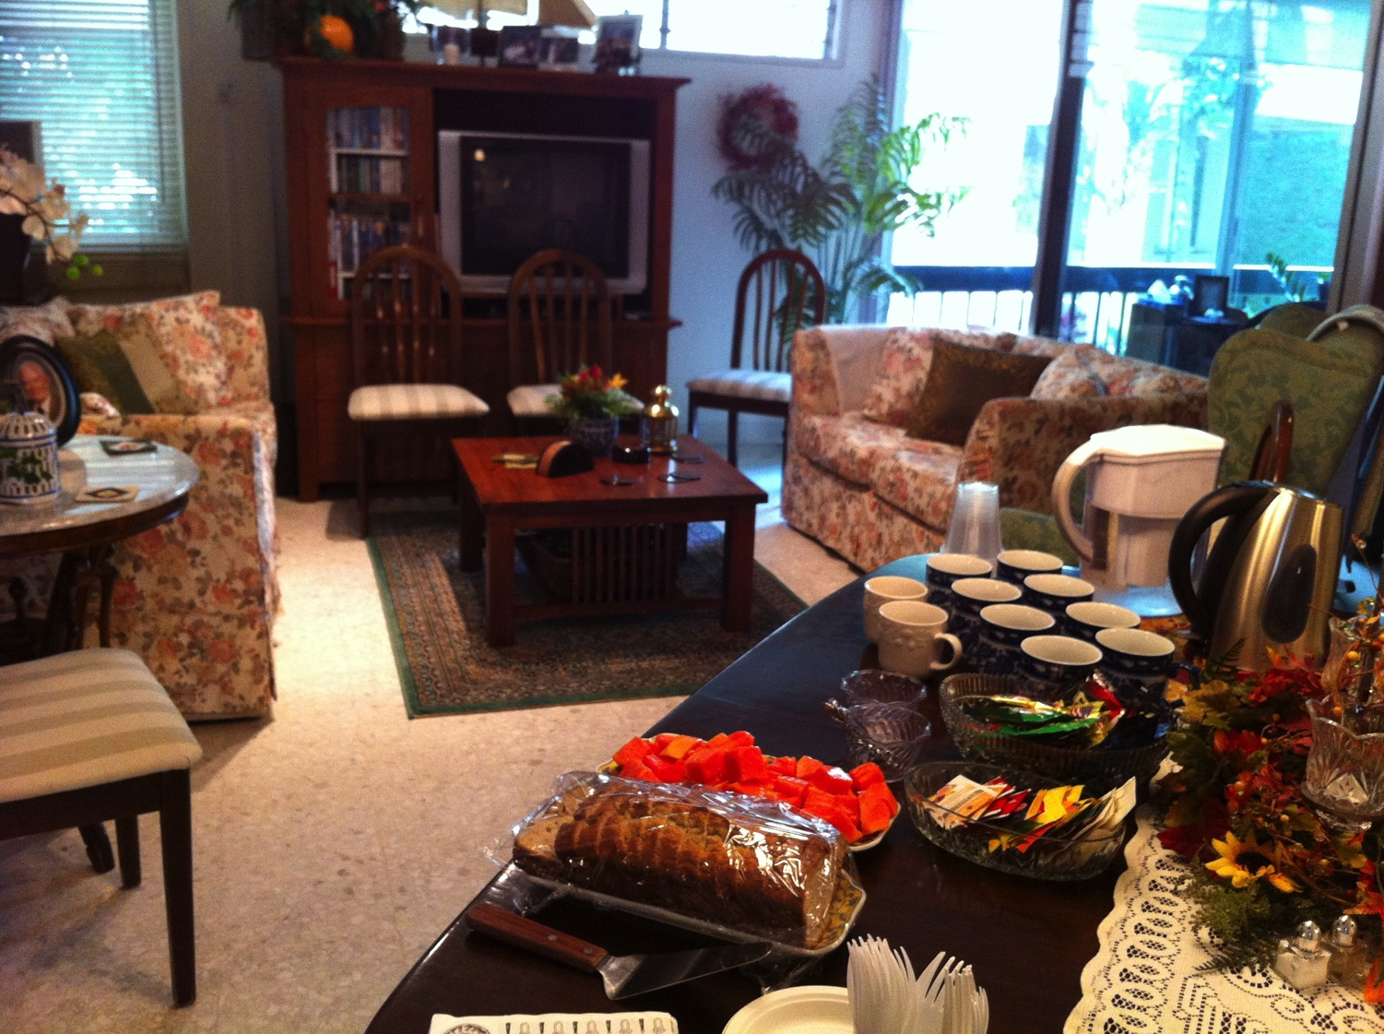
Prayer at our Singapore Bible College Apt. Friday 3 Aug 7-9 PM
9

Slide 102
Black

Slide 103


OT Preaching link at BibleStudyDownloads.org
Get this presentation and script for free!

